Slide 1



2025-12-19
OSS Strategy
Japan Local Meetup

Slide 2
Anti-Trust Policy Notice
Linux Foundation meetings involve participation by industry competitors, and it is the intention of the Linux Foundation to conduct all of its activities in accordance with applicable antitrust and competition laws. It is therefore extremely important that attendees adhere to meeting agendas, and be aware of, and not participate in, any activities that are prohibited under applicable US state, federal or foreign antitrust and competition laws.
Examples of types of actions that are prohibited at Linux Foundation meetings and in connection with Linux Foundation activities are described in the Linux Foundation Antitrust Policy available at http://www.linuxfoundation.org/antitrust-policy. If you have questions about these matters, please contact your company counsel, or if you are a member of the Linux Foundation, feel free to contact Andrew Updegrove of the firm of Gesmer Updegrove LLP, which provides legal counsel to the Linux Foundation.

Slide 3
Antitrust Policy
[Reference]
The meetings of the Linux Foundation (hereinafter referred to as LF) require the participation of industry competitors. LF operates all of its activities in accordance with all applicable antitrust/competition laws. Therefore, it is very important that meeting attendees exercise caution to ensure that the meeting follows the agenda and that they do not engage in any activity that is prohibited under domestic or foreign antitrust/competition laws.
Examples of prohibited activities at LF meetings and in connection with LF activities are described in the LF Antitrust Compliance Policy, available at https://www.linuxfoundation.jp/antitrust-policy/. If you have questions about these matters, please contact your company's legal counsel or, if you are a member of LF, contact LF's legal counsel, Andrew Updegrove of Gesmer Updegrove LLP.

Slide 4
Chatham House Rules
Follow Chatham House Rules
  Recording is not allowed
  You can share the information you receive as meeting notes,
  but don't reveal who said it.
Chatham House Rules

Slide 5
Code of Conduct
Follow the Linux Foundation Japan Code of Conduct
https://www.linuxfoundation.jp/code-of-conduct/
Unacceptable conduct (excerpts)
  Harassment in any form is unacceptable, including harassment based on gender, gender identity, gender expression, sexual orientation, disability, appearance, body size, race, age, religion, or any position or position protected by the laws of the country or region where the conference or program is held.
  Harassment also includes the use of abusive, offensive, or demeaning language, threats, stalking, harassing photographs or recordings, inappropriate physical contact, sexual images, and unwanted sexual advances or requests for sexual conduct.
  Participants who are asked to stop harassing behavior should promptly comply with the request. Witnesses or victims of unacceptable behavior should notify the conference organizers immediately.
Incident Response (excerpt)
  If a participant engages in harassing behavior, the conference organizers will take any action deemed appropriate in the circumstances, including warning the offender or expelling him or her from the conference.

Slide 6
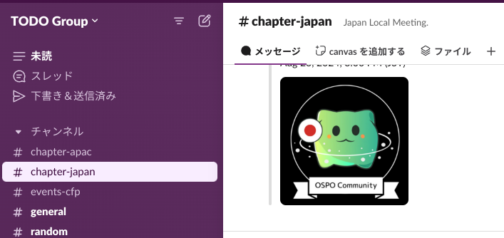
Administrative Communication
Communication Method
Slack: thetodogroup.slack.com
  #chapter-japan
Materials
  Slide Materials (this slide) https://docs.google.com/presentation/d/1nhHDVBFhkiQLJxJEQcsKTk1nAOrBlPYSt-SDP5xbe0w
  Discussion Sheet https://docs.google.com/spreadsheets/d/12aQYG-V8R-Svmi52draGb_Kcg21N__6Vn6v36QRFs94
  Weighting Sheet https://docs.google.com/spreadsheets/d/1A7ArTnbwh3t1fcShud-SqLru9K6zmYAokUH6Zxk5sSA
  These are personal account files, so please do not insert large size images.

Slide 7
OSS Strategy & Hosting Activities
Last updated 2024/10

Slide 8
OSS Strategy & Hosting
Business
cubic
OSS
Business
1
2 Business
2
OSS is essential to business
OSS itself does not generate profits
OSS utilization generates profits
Businesses close to and far from OSS
A meeting to consider the relationship and discuss issues
*The following and OSPO are not discussed
  Rules and processes
  KPI
  Organization, Internal Structure, Internal Cooperation
  Compliance
Business
Secondary
Business
3
Notes:
OSS is essential to business
OSS itself does not generate profit
Profit is generated through OSS utilization
Businesses near and far from OSS
Think about the relationship between them,
and discuss issues
do not focus on discussion about internal rules, process samples related with OSS in company, OSPO KPI, etc.

Slide 9
OSS Strategy & Hosting
Imagine the challenges of OSS activities for companies (personas) that use OSS for their business.
  Linux distro vendors
  Automotive and telecommunications industries
  Semiconductor vendors
  Online sales services
  Cloud services (not yet considered)
  OSS consulting services (not yet considered)
Required OSS contribution Activities are similar
However, each activity has a different business impact
Notes:
Imagine the issues of OSS activities of companies (persona) who do business by leveraging OSS
Almost the same OSS contribution activity items required
However, the impact of each activity on the business is different.

Slide 10
OSS Strategy & Hosting
Business
Third
OSS
Business
Primary
Business Second
Business Third
OSS business strategy and OSS in-house
Hosting initiatives
  OSS use and license compliance
  to achieve a higher stage (participation, contribution,
  leadership)
Businesses close to and far from OSS
Consider the relationship and discuss issues
  OSS is essential to business
  OSS itself is not profitable
  OSS utilization is profitable
  Visualization of these relationships to OSS
  Make it possible to explain the legitimacy of efforts
Business
Secondary
Business
Third
Notes:
OSS is essential to business
OSS itself does not generate profit
Profit is generated through OSS utilization
Businesses near and far from OSS
Think about the relationship between them,
and discuss issues
do not focus on discussion about internal rules, process samples related with OSS in company, OSPO KPI, etc.

Slide 11
OSS Strategy & Hosting
Motivation
  Realization that there is a barrier from use to the next stage (Participation, Contribution, and Leadership)
Assumed issues
  It is difficult to see the path and role models to move from use to contribution
  Wouldn't it be nice to have an OSS strategy that can be used as a more specific reference?
  Your OSPO is not my OSPO, but even if each OSPO is separate, isn't there a common point or best practice among industries and business types?
Provide specific examples that can be used as a reference
  Introduce typical examples for each industry and business type
  Mutual introduction of OSPO initiatives by each company at LT (to be considered for future Meetups)
Notes:
Imagine the issues of OSS activities of companies (persona) who do business by leveraging OSS
Almost the same OSS contribution activity items required
However, the impact of each activity on the business is different.

Slide 12
OSS Strategy & Hosting
Imagine the challenges of OSS activities for companies (personas) that do business using OSS
  Linux distro vendors
  Consumer electronics vendors
  SIer
  Telecommunications companies
  Automotive manufacturers
  Semiconductor vendors
  Web services companies
  Universities and research institutions
  Corporate R & D department
  Local governments and public institutions
Required OSS contribution activities are almost the same
However, the degree of business impact of each activity varies.
Notes:
Imagine the issues of OSS activities of companies (persona) who do business by leveraging OSS
Almost the same OSS contribution activity items required
However, the impact of each activity on the business is different.

Slide 13
OSS Strategy & Hosting Common (under development)
 | Common
Business Overview
Desired Effects of OSS
Initiatives to Realize Objectives | - Recruitment of Human Resources - Dissemination of Information - OSS Human Resource Evaluation? Culture Creation?
OSS Activities to be Implemented | High priority
This gap may be important in the FAQ.
Notes:
Imagine the issues of OSS activities of companies (persona) who do business by leveraging OSS
Almost the same OSS contribution activity items required
However, the impact of each activity on the business is different.

Slide 14
OSS Strategy & Hosting persona case study (under construction)
 | Linux distro vendors | Consumer electronics vendors | SIer companies | Telecommunications carriers
Business overview | Linux technology services sales | product sales | System contracting and solution development | Telecommunication services provision
The primary goal of OSS | Dissemination and reinforcement of the company's distro | Efficiency of product development and enhanced support | Efficiency improvement from development to operation and maintenance | Ensuring quality and safety in a huge supply chain in the transition to a software-defined era based on OSS
Efforts to realize the objectives | ・Expanding the user base ・Strengthening distro ・Ensuring project sustainability | ・Support for standard interfaces ・Improving product development efficiency (enhancing functionality/supporting short-term development) ・Achieving long-term product support | ・Strengthening the lineup of DX solutions ・System development experience ・Strengthening presence ・Utilizing OSS to lower costs and make it easier to receive orders | ・Establishing industry standards (standardization) ・Achieving vendor neutrality ・Achieving long-term product support
OSS activities to be implemented | High Priority - Patch Post - Participate in regular community internal meetings (GB, AB, TSC) | High Priority - Report defects - Register issues - Present case studies - Survey, evaluate and select OSS community Shouldn't it be added? - Information dissemination is important in every industry? | High Priority - Patch Post - Maintainer - Report Defects - Issue Register Should it be added? - Sponsor implementation (It is difficult to explain unless it is linked to business strategy. It is necessary to explain that it is necessary to acquire positions and to strengthen the presence. It is difficult to explain if raw OSS is not directly useful for business.) (It is also necessary to disseminate information on initiatives of value at the business level) | High priority - Report defects - Issue registration - Presentation of case studies - Gathering colleagues in the community (finding business partners) - To realize standardization - JDF is the link between standardization realization and OSS - JDF is certified as a PAS (Publicly Available Specification) submitter by ISO/IEC JTC 1, an international standardization organization. JDF is an organization (not related to communications) that supports the flow from de facto to standardization that emerged in OSS. - To improve the quality of the system actually in operation and to deal with problems
This gap explanation may be important in the FAQ.
Notes:
Imagine the issues of OSS activities of companies (persona) who do business by leveraging OSS
Almost the same OSS contribution activity items required
However, the impact of each activity on the business is different.

Slide 15
OSS Strategy & Hosting Persona Case Study (under construction)
 | Automotive Manufacturers | Semiconductor Vendors | Web Services Company
Business Overview | Automotive Manufacturing and Sales | ・Expanding sales of LSI, SoC, and other manufacturing chips | Developing and providing Web services
The primary goal of OSS | Ensuring quality and safety across a huge supply chain in the transition to a software-defined era based on OSS | Making in-house LSIs available on OSS platforms | Achieving efficient function provision and operation of service platforms
Efforts to realize the objectives | ・Establishing industry standards (standardization) ・Achieving vendor neutrality ・Achieving long-term product support | ・Upstream in-house LSI drivers ・Promoting a solution development community that leverages LSI capabilities | ・Optimizing cloud maintenance costs
OSS activities to be performed | High priority - Report defects - Register issues - Present use cases - Community fellowship (find business partners) | High priority - Patch submission - Maintainer (patch review, etc.) - Report defects - Issue registration - Present use cases | Medium priority - Post patches - Report defects - Attend regular community internal meetings (GB, AB, TSC) - Sponsor implementation
Notes:
Imagine the issues of OSS activities of companies (persona) who do business by leveraging OSS
Almost the same OSS contribution activity items required
However, the impact of each activity on the business is different.

Slide 16
OSS Strategy & Hosting Personas (under construction)
 | Universities and research institutes | Corporate R & D departments | Local governments and public periods
Business outline | Disclosure of research results and recognition | Disclosure of research results and application to business | Provision of citizen services
The primary aim for OSS | Development and education of cutting-edge technologies | Development and commercialization of cutting-edge technologies | Efficient and widespread provision of citizen services → Realization of standardization (horizontal expansion) → Application of administrative software to OSS
Efforts to realize the objectives | ・Academic paper presentation (OSS event presentation after paper presentation) ・Education through contributions to OSS | ・Academic paper presentation (OSS event presentation after paper presentation) ・Incorporation of feedback through contributions to OSS | ・Need for OSS utilization guidelines ・Launch and activation of OSS community (OSS hosting) ・Promotion of inner sources among municipalities
OSS activities to be implemented | High priority - Announcement of Meetup - Announcement of use cases - Gathering friends (finding business partners) - Formation of local community - Technical education - OSS development method education | High priority - Meetup announcement - Use case announcement - Gathering friends (finding business partners) - Building local communities | High priority - Building common standards - Building local communities
Notes:
Imagine the issues of OSS activities of companies (persona) who do business by leveraging OSS
Almost the same OSS contribution activity items required
However, the impact of each activity on the business is different.

Slide 17
Sales of services related to OSS
(primary)
2024-03-15 View

Slide 18
First: Companies serving as OSS
Main place of value for business
  Provide value mainly by providing OSS
Linux as an example, distro vendor?
  Redhat Linux
  Cannonical
  Windriver
  MIRACLE LINUX
Relationship with OSS community
  Maintainer, operator or core member of Linux community

Slide 19
Primary: Companies serving as OSS
Business issues
  Certification from hardware vendors (for new hardware)
  Compatibility maintenance (backport)
  Security measures (version upgrade and distribution)
  Technical support
Business value
  OSS itself is not sold (Not a ban on buying and selling, but as a value. This is not enough to sell.)
  Combined OSS offering (You can verify it yourself, but there are many combinations.)
  Maintenance replacement (You can maintain it yourself, but outsourcing is better and more effective.)
  Technical Inquiries (I can find out for myself, but it's faster to ask.)
  Authentication is Business Required

Slide 20
First: Companies providing services as OSS
OSS strategy and actions
  Ability to maintain OSS as a distro
    Patch posting
    Document maintenance (Expansion of developers and users)
    Community communication, operation support, operation promotion (maintaining distro base)
  OSS development leads to expansion of potential customers
    Meet up events and seminar events (expansion of users)
  Improve business value (Brand?)
    Continue posting patches
  Forming the de facto
  Can be asked to developers
  (It may not be a strategy, but posting patches is linked to training engineers.)
Patch posting
Community support
Meetup

Slide 21
OSS as a platform
is the difference between
using specific features of OSS
to provide services
?
Why don't you compile it in a table?
 | Patch posting
Community survival | ◯ ◎
Development of OSS, expansion of potential customers

Slide 22
2024-03-15
Listed separately by telecommunication business (entity)
Expand the URL of the slide and Spreadsheet (homework)
From 15:00 on 4/12.

Slide 23
2024-04-12
For the automotive and telecommunications industries

Slide 24
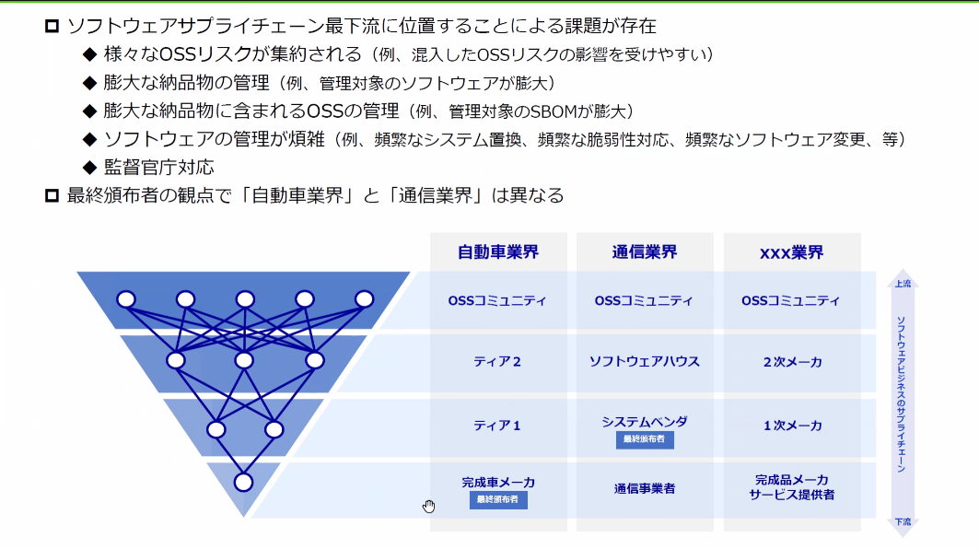
2024-04-12
The OSS community is important in both the telecommunication and automotive industries.
We are trying to find an OSS strategy.
  We don't want OSS to disappear, so we recognize the need for activities to help the community remain.
We argue that finished vehicle manufacturers receive finished products from Tier 1.
Industry standards are made up of the community.
  Looking at the big flow over 5 or 10 years, we get the impression that finished product manufacturers/telecommunication carriers are presenting the flow.
    For telecommunication carriers, 3GPP is such a flow.
  It is healthy if it is made up of the OSS community including interoperability.

Slide 25
2024-04-12
A project to develop and standardize the Teleco API
  https://camaraproject.org/
  These projects are needed to be interconnected, and leading them would be a good OSS strategy.
How do these cross-industry projects stand up?
  They can be brought to The Linux Foundation for discussion.
  Who gets the code base for Open Daylight or something.

Slide 26
2024-04-12
Are there no claims in the SBOM?
  What do you do if the software you don't like is included in the SBOM?
  (Apple and others have certification)
  We don't have enough engineers to handle it ・・・
  We are aware that there are cases where people ask us not to include this license.
Do telecom operators also have concerns about AGPL?
Can we ask the OSS community to review the license?
  If the range of usage expands, it will be important to change the license to suit the usage.
As SBOM develops, it will become clear which OSS is used.
  You can rank OSS that are important to your business

Slide 27
2024-04-12
I want SBOM generation at build time. I submit requests to the OSS community.
  The OSS community across the business considers it important.
  Imitation of the first mover
  👉 It is important that the OSS community that our company considers important is widely used in business, so I think it is an OSS strategy to give opinions to such business-related OSS.
Do you ever request OSS activities to client companies?
  Not now. We do not request work to companies in contract relationships, and we contribute according to licenses.
  How about requesting OSS activities in the form of giving back to the community (making efforts)?
  By contract ・・・ (I want to create a culture of contribution throughout the industry)
  👉 When we put special functions into OSS and delivered it, we were asked to choose between adding the maintenance cost of the patch every time we upgrade or giving back the developed patch to the community to reduce the cost. We were mostly allowed to give back to the community.

Slide 28
2024-05-10
For semiconductor vendors

Slide 29
2024-05-10
Business: Suppliers to build boxes
  Profit and software are separate, not directly linked
  Midstream as a supply chain. Receive from upstream IP vendors and wholesale to downstream manufacturers.
Moving from standards first to OSS first
What will you do to the OSS community?
  Fostering, sponsorship
  Create a community. Hosting.
Many companies such as Intel and NVidia participate in projects under LF.
  Fostering is an action to keep their own semiconductors available
  I want them to be included in the larger community as maintenance.

Slide 30
2024-05-10
ARM is launching a non-profit around Linaro
  Hiring software engineers from non-profits
It's becoming more important to do things that aren't directly tied to your business

Slide 31
2024-06-14
For online sales services

Slide 32
2024-06-14
Using OSS for product creation (as expected)
  Using OSS as an internal tool
    URL shortening, using OSS as part of a question-answering bot for internal communication tools, etc.
  Basic OSS(Python, PHP, etc.) is decided as a sponsor based on the number of uses and importance
  Exhibiting a booth at OSS-related events. Advice has been made by engineers, and the company has decided to implement it
    For networking and motivation of engineers
    We try not to make the fact that the company is sponsoring it front and center

Slide 33
2024-06-14
There is a clear policy regarding OSS activities
  Contributions are allowed. Statistics such as the number of cases are not collected.
  We use blogs and videos to show that we are actively using OSS and that we can contribute.
  There are no restrictions on activities (to keep engineers motivated)
OSS publishing
  We have a company account on Github where we can decide whether to publish.
  We have a publishing flow. After a minimum tool check such as license violation, we have automated it so that it can be checked by each department.
  Publish in units of github repositories
  After publishing, appeal on SNS and blogs

Slide 34
2024-06-14
OSPO started with engineers raising OSS licensing issues.
Some software is being moved from OSS licenses to Business licenses, which is an issue.
  Engineers are on the lookout, and OSPO is contacted (the culture is).
  Policy violations in scanning tools are alerted.

Slide 35
Assumed results of issues in persona companies
Contribution activities have many common elements
Each persona company has a different degree of impact

Slide 36
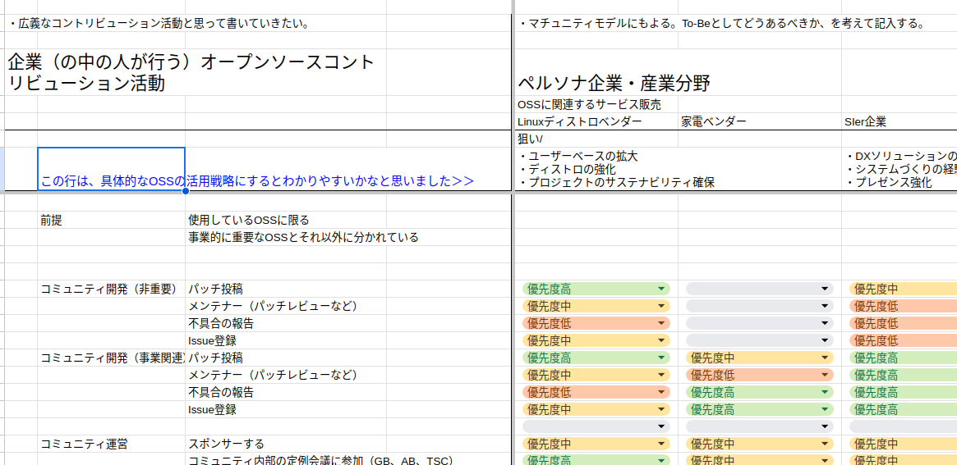
OSS Strategy & Hosting
of contribution activities and their impact in each persona company.
We are discussing the weighting
Please join us
(URL)
Notes:
Discussing the weight of each contribution activity items and its impact per each persona company.
Please join us!

Slide 37
December Agenda
202504
12/19 (Fri) 15:00 ~
  Organizing the objectives of "weighting OSS activities"
    I summarized it for the LF Japan Community Days the other day, but if I just extract the high priority, I feel inadequate explanation and strange.
      Don't you need a background story?
    Proceed with organizing the stack and indicators of "objectives of persona companies and industry fields" and reorganize persona companies based on that.
  About the LT to introduce OSPO start-up cases
    I want to do it at the OSPO Japan WG event
    Introduced at LF Japan Community Days and OSSJ joint session
    It might be good to have IPA introduce it too
      https://www.ipa.go.jp/event/2025/briefing-ospo-workshop20251002.html
  continuation of the discussion on how to organize

Slide 38
About the next meeting
202504
1/9 (Fri) 15:00 ~
  Organizing the aim of "weighting OSS activities"
    Organizing the common parts and parts by persona
    Continuing to fill in the gaps
  How to put it together Continuing the discussion

Slide 39
November Agenda
202504
11/14 (Fri) 15:00 ~
  Organizing the objectives of "weighting OSS activities"
    I summarized it for the LF Japan Community Days the other day, but if I just extract the high priority, I feel inadequate explanation and strange.
      Don't you need a background story?
    Proceed with organizing the stack and indicators of "objectives of persona companies and industry fields" and reorganize persona companies based on that.
  About the LT to introduce OSPO start-up cases
    I want to do it at the OSPO Japan WG event
    Introduced at LF Japan Community Days and OSSJ joint session
    It might be good to have IPA introduce it too
      https://www.ipa.go.jp/event/2025/briefing-ospo-workshop20251002.html
  continuation of the discussion on how to organize

Slide 40
October Agenda
202504
10/10 (Fri) 15:00 ~
  Organizing the Aims of Weighting OSS Activities
    Organizing the stack and indicators of the Aims of Persona Companies and Industry Fields, and reorganizing Persona Companies based on that
    Reflecting the opinions received based on this draft, I would like to brush up the weighting of Persona Companies toward the final version.
    Furthermore, for companies that want to host OSS in-house, the approach will change from Persona Companies to what kind of strategies they take using OSS.
  LT on OSPO Start-up Case Study
    I would like to do it at the OSPO Japan WG event
    I would like to introduce it at LF Japan Community Days and OSSJ joint session
    It might be a good idea to have IPA introduce it as well
      https://www.ipa.go.jp/event/2025/briefing-ospo-workshop20251002.html
  Launch of OSPO
    LACK OF EXECUTIVE BUY-IN was mentioned in the 2025 report
      https://www.linuxfoundation.org/hubfs/Research%20Reports/LFResearch_StateofOSPO_082025.pdf?hsLang=en
  What is the relationship between AI and OSPO?
    OSPO is asked because they are concerned about licensing
    OSS is asked because it is essential to advance AI strategy
    OSPO is asked because it is related to Open Data
    OSPO is asked if there is no AI department?
  How to wrap up The discussion continues

Slide 41
September Agenda
202504
9/12? (Fri) 15:00 ~
  Organizing the Aims of Weighting OSS Activities
    Organizing the stack and indicators of the Aims of Persona Companies and Industry Fields, and reorganizing Persona Companies based on that
    Reflecting the opinions received based on this draft, I would like to brush up the weighting of Persona Companies toward the final version.
    Furthermore, for companies that want to host OSS in-house, the approach will change from Persona Companies to what kind of strategies they take using OSS.
  Continuing the discussion on how to summarize

Slide 42
August Agenda
202504
8/8 (Fri) 15:00 ~
  Arrangement of "OSS Activity Weighting" Objectives
    Proceed to organize the "Objectives of Persona Companies and Industry Fields" stack and indicators, and reorganize Persona Companies based on that
    Based on the discussion up to today, review and shape the weighting based on the reorganized version of Persona Companies
  Summary Continuation of the discussion

Slide 43
June Agenda
202504
6/13 (Fri) 15:00 ~
  Arrangement of "OSS activity weighting" objectives
    Proceed with the arrangement of stacks and indicators of "objectives of persona companies and industry fields (for arrangement)" and rearrange persona companies based on them
    Based on the discussions up to today, we will make a draft of the rearranged version of persona companies (Takanori)
  Conclusion Continuation of the discussion

Slide 44
May Agenda
202504
Organizing the Aims of Weighting OSS Activities
  Organizing the stacks and indicators of the Aims of Persona Companies and Industry Fields (for organizing) and reorganizing Persona Companies based on them
Summary Continuation of the Discussion
About the Next Meeting

Slide 45
April Agenda
202504
"Weighting OSS Activities" Aims Organized
  Persona company x assumed strategy (there may be multiple depending on the strategy level)
    Aims of Persona companies and industry fields (for organizing) were divided into stacks and characteristics were extracted (in progress)
Summary Continued discussion
About next time

Slide 46
About the next meeting
202504
5/9 (Fri) 15:00 ~
  Arrangement of "OSS activity weighting" objectives
    Proceed with the arrangement of stacks and indicators of "objectives of persona companies and industry fields (for arrangement)" and rearrange persona companies based on them
  Conclusion Continuation of discussion

Slide 47
March Agenda
202503
Review line 8 of "Weighting OSS Activities" Discussion
  There may be divergence between persona companies and assumed strategies (there may be multiple strategies depending on the strategy level)
Review and discuss "Weighting OSS Activities" as a whole
Summary Continuation of discussion
About next time

Slide 48
Weighting sheet, line 8: "Aim"
202503
Wouldn't it be better to narrow down the aim?
  For example, "securing human resources" would be a common aim for all industries and companies.
  How about summarizing it as the main aim?
If you write down the outline of the business, have the main aim, and make efforts to achieve it, it will be well organized.
If you organize the relationships between companies, can you see the aim of each company (the combination when customers purchase)?

Slide 49
Consultation on how to summarize the results of OSS Strategy discussion activities
202503
Intended audience:
  Proposal: For Japanese people who want to start OSS Strategy
    It will be used to raise awareness toward C level
  Proposal: (Interview with people who attend IPA's OSS Strategy Seminar)
Output format:
  First, in slide format.
  I would like to see spreadsheets and documents as appendices and supplements.
Distribution location: Via TODO Group? Speakerdeck?
  (Addendum: OSPO FAQ not yet distributed.)
  Suggestion: If the TODO Group could prepare it for Japan, that would be great.
Suggestions:
  OSPO Con w/ OSSummit NA/Europe/Japan
  TODO OSPO Book Meeting

Slide 50
About the next meeting
202503
4/11 (Fri) 15:00 ~
  Organizing the objectives of "weighting OSS activities"
  How to summarize Continue the discussion

Slide 51
February Agenda
Brief review of the previous report (1/10)
  Additional comments on "Weighing OSS Activities"
Continuation of "Weighing OSS Activities"
  Organization of contribution activities
  Consultation on how to summarize the results so far
About the next meeting

Slide 52
Consultation on how to summarize the results of OSS Strategy discussion activities
Intended audience:
  Proposal: For Japanese people who want to start OSS Strategy
    It will be used to raise awareness toward C level
  Proposal: (Interview with people who attend IPA's OSS Strategy Seminar)
Output format:
  First, in slide format.
  I would like to see spreadsheets and documents as appendices and supplements.
Distribution location: Via TODO Group? Speakerdeck?
  (Addendum: OSPO FAQ not yet distributed.)
  Suggestion: If the TODO Group could prepare it for Japan, that would be great.
Suggestions:
  OSPO Con w/ OSSummit NA/Europe/Japan
  TODO OSPO Book Meeting

Slide 53
About the next meeting
3/14 (Fri) 15:00 ~
  Review line 8 of "Weighting OSS Activities" Discussion
    There may be divergence due to persona company × assumed strategy (there may be multiple strategies depending on the strategy level)
  Review and discuss the overall "Weighting OSS Activities"
  Summary Continuation of discussion

Slide 54
January Agenda
Introduction of OSS Strategy + Q & A
Continuation of "Weighting OSS Activities"
  Additional discussion on contribution activities
  Fill in the unfilled areas
Future

Slide 55
September Agenda
About 10/18 OSPOjp Meetup (OpenChain JP Co-located event)
Weighting continuation

Slide 56
10/18 OSPOjp Meetup (OpenChain JP Co-located event)
Ana (TODO Group LF member) Invitation OK.
Draft agenda
  Please introduce global activities. by Ana
  Introduction of OSPOjp activities (slides in English). by Motai, Owada
    We would like to discuss how to show the output of OSPOjp activities.
  LT competition. We also want Ana to listen.
    The questionnaire is displayed in English and Japanese. It is tallied on the spot and excited.
    If there are people who want to talk, ask them to talk.
  OSPO Whatever Consultation Meeting No. 2.
  (If only the usual people gather) The usual activities.

Slide 57
August Review
Let's summarize the weight of OSS activities by field in a table.
  Sheet: OSPO Japan Local Meetup - OSS Strategy, Weight Sheet
    *Let's define the license and publish it.

Slide 58
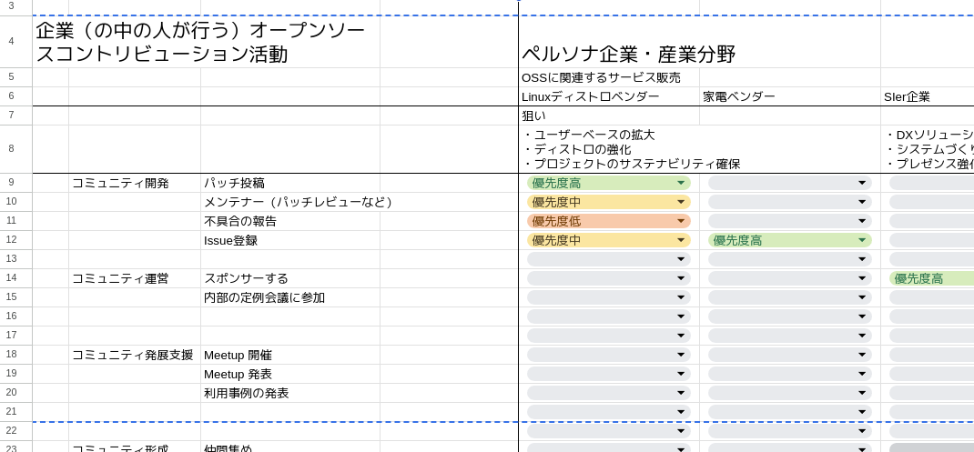
Image (priority input is appropriate)

Slide 59
July Review
Although the “weights ” are different, there are similarities in activities across fields.
  Weight: In ◯◯ fields, sponsorship is more important than patch posting.
  It would be interesting to compare weights across fields.
  It would be interesting to learn more about why different weights occur.
Reference:
  Open Source Program Office; OSPO definition and guide
  [WHY] Externally, OSPO serves as an important bridge between organizations and the open source community, helping to ensure that organizations are good stewards of open source software and maximizing the benefits while minimizing the risks of open source adoption. Internally, ....

Slide 60
August Memo
Do strategies change due to changes in the positioning of software?
  AI examples) codeware, promptware, ..., agentware
  https://arxiv.org/pdf/2402.15943
  I wonder if this kind of movement is emerging as the talk of open sourcing around AI after Sotware2.0. Model Openness Framework
    https://lfaidata.foundation/blog/2024/04/17/introducing-the-model-openness-framework-promoting-completeness-and-openness-for-reproducibility-transparency-and-usability-in-ai/
There are some cases where SIers' activities are limited to using OSS.
  It is fine if OSS is sustainable, but it is bad if OSS is actually broken.
Next 9/13

Slide 61
September Memo
I filled in the table.
  Each business line has a different approach to OSS, so I cannot say that the company is like this.
While filling in the table, it is worthwhile to discuss where you are hesitant.
  The contribution to OSS changes depending on whether it is related to your own business.
  For example, the importance of pytorch differs between companies that value it and those that do not.
Comment
  Does it change if you set the aim of the persona company?
  I thought it would be easier to understand if you make specific OSS utilization strategies.
  You separated it as a persona company, but should you separate it as a persona business?
  Does "community development" change when classified into communities? -- > Next month: Discussion on how to divide and fill in to make sure
    AI community, Linux community, Cloud community
    Communities like OpenChain
Next time: 10/18 OSPOjp.

Slide 62
Current
Discussion Topics

Slide 63
OSPO Adoption Strategy and OSS Strategy
We will discuss this.
Recognize OSS that is important to your business
How to get involved
  Contribution
  Foundation Sponsor
  Maintainer ・・・
What should we do within the company to get involved?
  Rules and Processes
  KPI
  Organization, Internal Structure, Internal Collaboration
  Compliance
What do we need OSPO to do?
Should we discuss OSS strategy with products and services?
  How do we summarize OSS strategy next time?
  We will recommend OSPO strategy in QA.
We will discuss the issues of OSS strategy.
The issues of OSPO organization establishment and activities
We will not discuss (for now)

Slide 64
How to summarize the results
Business
Tertiary
Business
Secondary
Create a slide from a spreadsheet
I made it easily
I want to brush it up
Business
Tertiary
Business
Secondary
Business
Primary
OSS

